Slide 1
Medical Inventory Optimization Dataset
By using Python codes

Slide 2
EDA / Descriptive Statistics
Optimizing medical inventory is a critical aspect of effective healthcare management. In the healthcare industry, the abundance of data related to supplies, medications, and equipment presents an opportunity for comprehensive analysis using Python code.
The utilization of Python scripts plays a central role in mining and analyzing this data, offering valuable insights into inventory levels, consumption trends, and supply chain efficacy across time frames.
This inventory optimization initiative focuses on harnessing Python scripts to explore this data, empowering healthcare providers to make informed decisions. By examining inventory databases and transactional logs, our goal is to streamline inventory management processes, reduce unnecessary wastage, and ensure the availability of necessary supplies when needed. Ultimately, this approach aims to elevate the quality of patient care and operational efficiency within healthcare facilities by leveraging the capabilities of Python for data analysis and management.

Slide 3
Overall design strategy
The total count of this medical inventory optimization dataset is about 14219
The idea is to derive insights from this vast dataset so we can do further analysis.
The plan is to remove all the outlier values and get a data that will be much useful
This dataset is about all the sales and return happened in a pharmacy in the year 2022
USERS –The ones who use this visuals
The OWNER of the drug store : To get a idea on how he should buy the drugs in way there is
No wastage of drugs
Finding the pattern of the drug sales
To find the pattern of his buyers
To plan his next drug delivery to his store

Slide 4
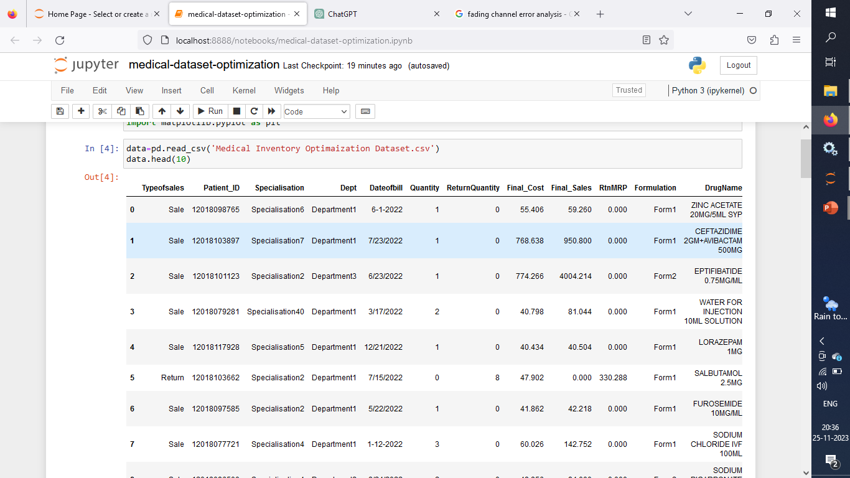
Getting to know – the Dataset
data=pd.read_csv('Medical Inventory Optimaization Dataset.csv')
data.head(10)

Slide 5
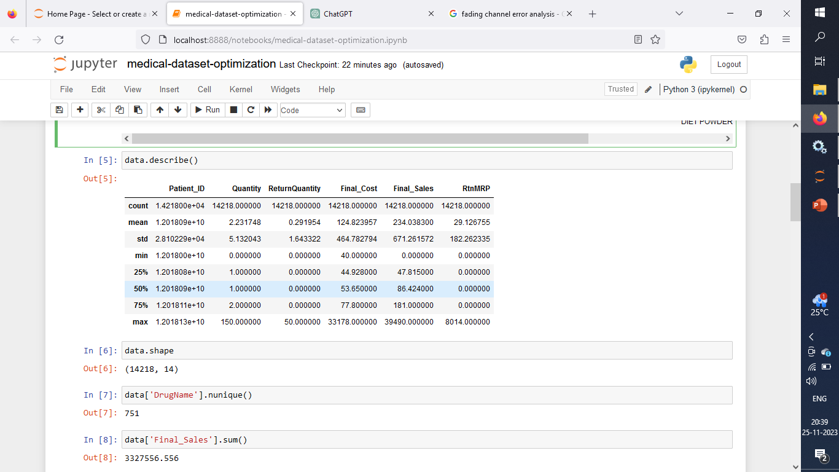
2. Getting the Statistical insights from the dataset
data.describe()

Slide 6
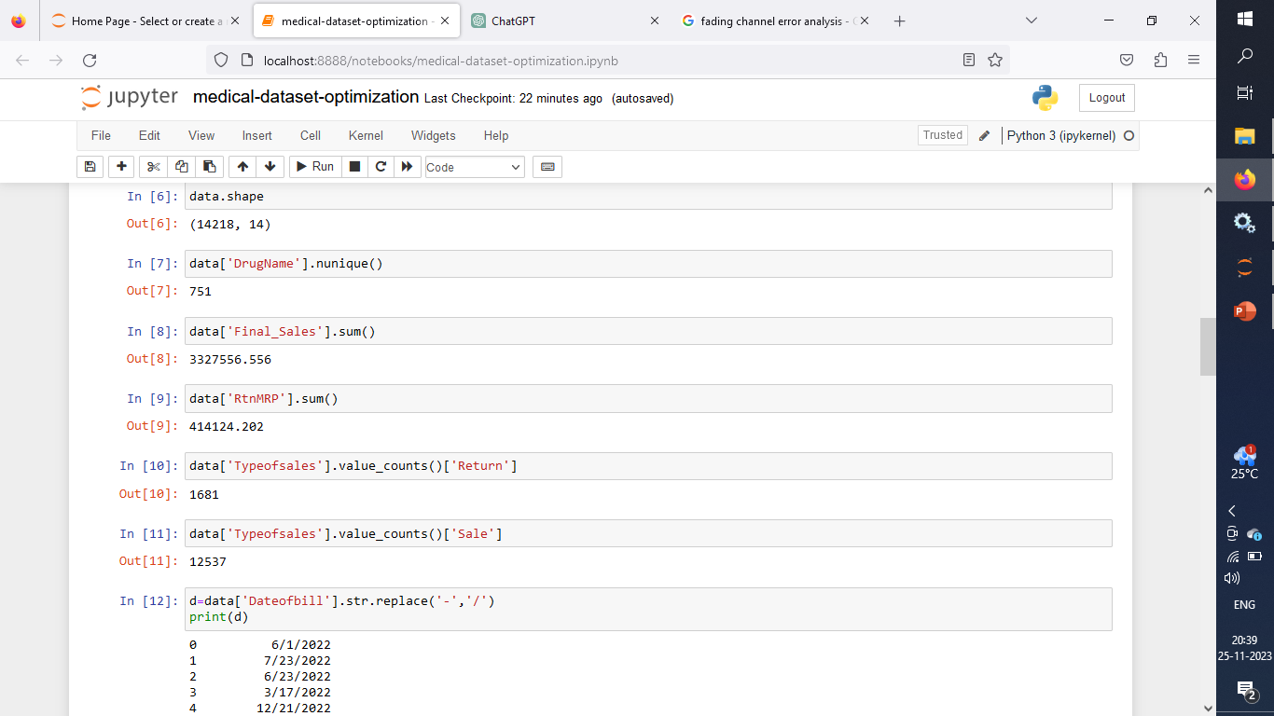
3. Getting Basic insights from the Dataset
data.shape() //rows and coloumn
data['DrugName'].nunique() //finding unique drug-names
data['Final_Sales'].sum() //Total sales -2022
data[‘RtnMRP’].sum() // Total -Return amounts -2022
data['Typeofsales'].value_counts()['Return’] //total count of returns
data['Typeofsales'].value_counts()['Sale’] //total count of sales

Slide 7
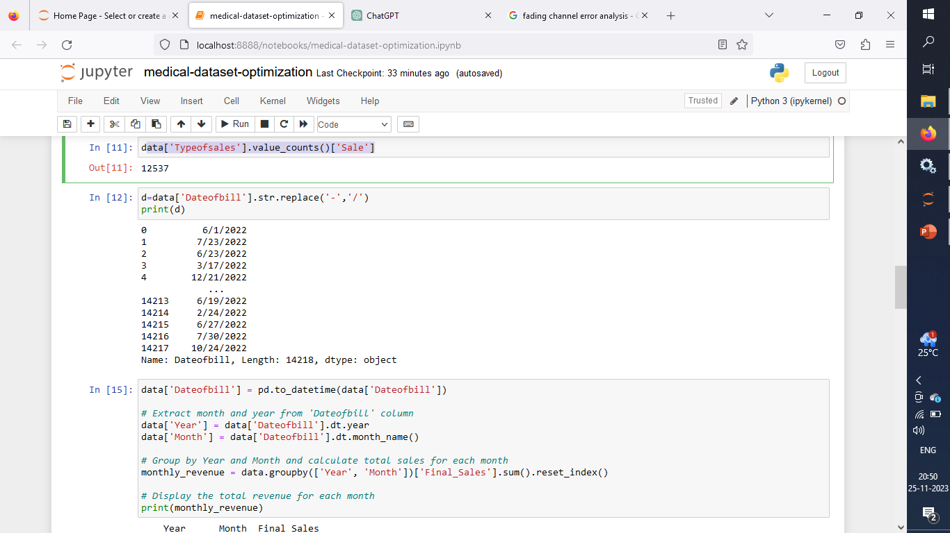
4. It is found that the dates are not represented in the same way
d=data['Dateofbill'].str.replace('-','/')
print(d)

Slide 8
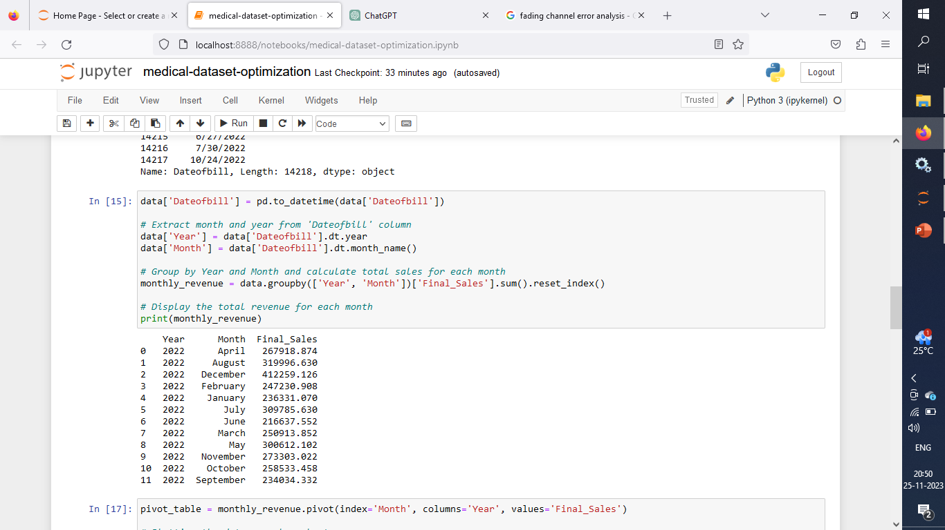
5. To get a month wise revenue generated from the sales
Extracting the month and year so that we can analyse that.

Slide 9
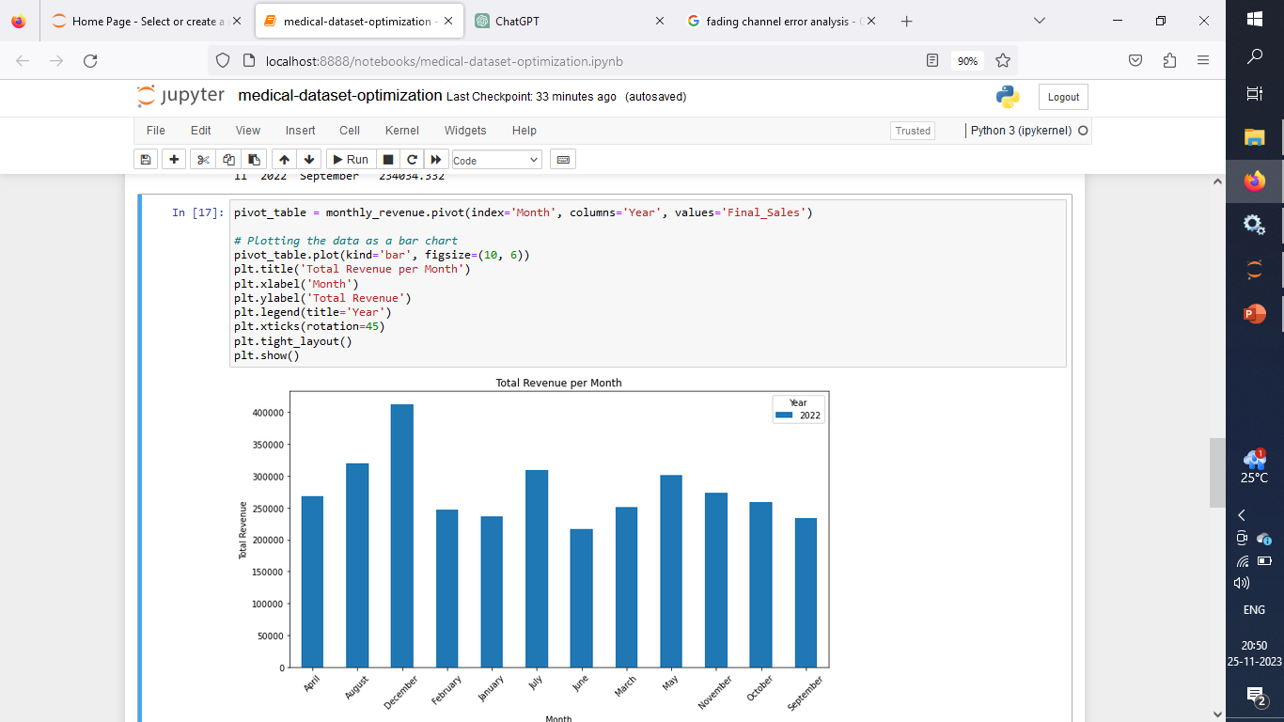
6. Visuals makes it easier to get insights
December has the highest revenue generated.

Slide 10
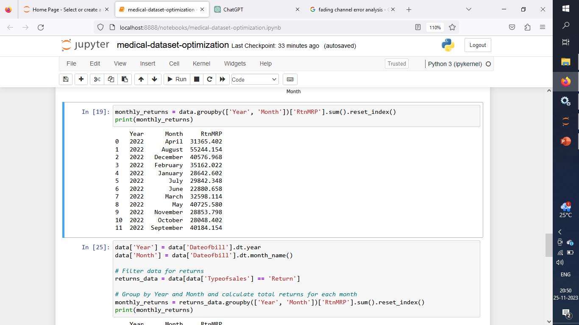
7. Total amount of drugs returned every month

Slide 11
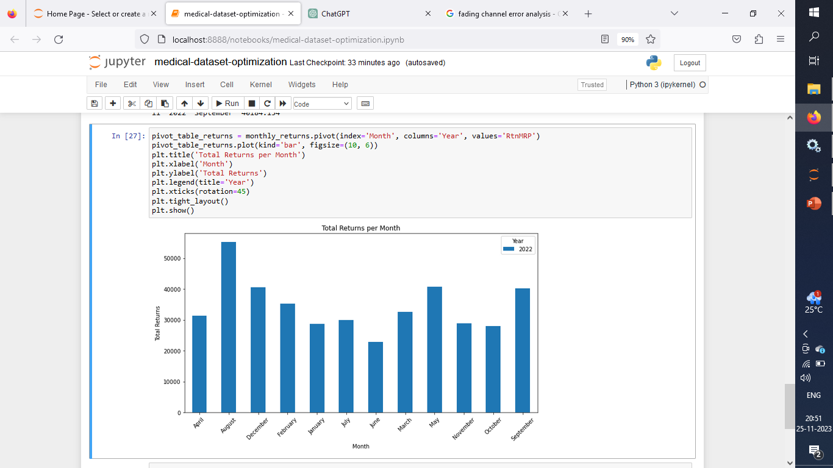
8. Visuals make it easier to understand business insights
August month has the highest returns

Slide 12
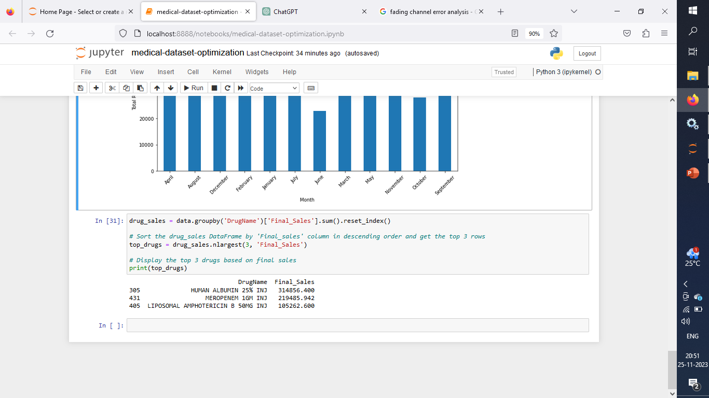
10. Popular drugs – Top 3

